Slide 1
Database Systems Term Project: Library Database
Dominic Polletta

Slide 2

Library System
My mother is a librarian
A library system has a lot of hidden complexity
Good sources of valid data
Easily verifiable system

Slide 3

What is needed
Information about books
Information about readers
What readers took out what books

Slide 4
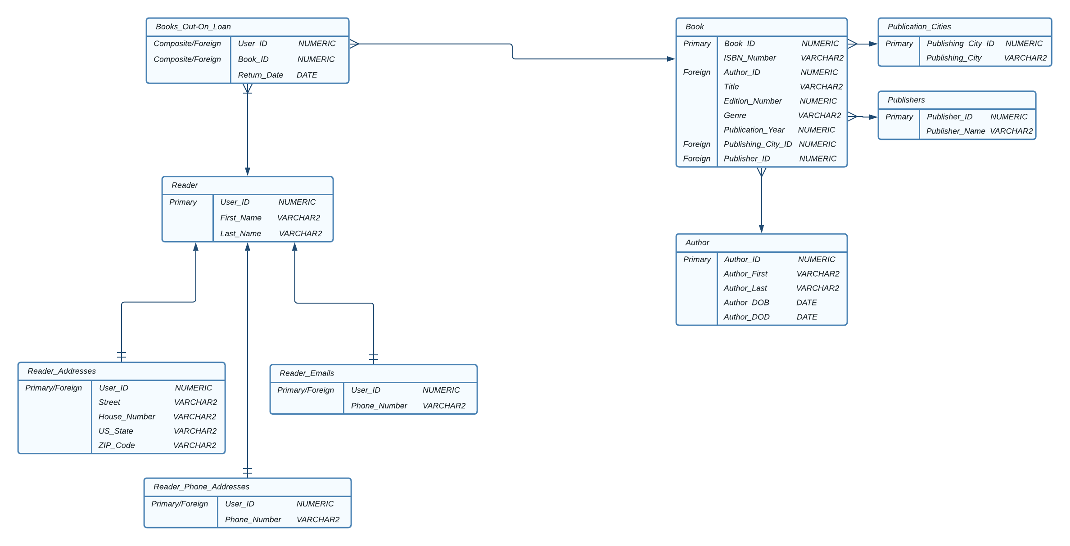
Conceptual Model

Slide 5

SQL Developer
SQL Developer is an IDE for Oracle SQL development
Allows for reading of data in tables without using SELECT statements
Prettier than Windows terminal

Slide 6
Table Creation
CREATE TABLE Book(
Book_ID NUMERIC(7),
ISBN_Number NUMERIC(5) NOT NULL,
Author_ID NUMERIC(5) NOT NULL,
Title VARCHAR2(50) NOT NULL,
Edition_Number NUMERIC(1) NOT NULL,
Genre NUMERIC(5) NOT NULL,
Publication_Year NUMERIC(4) NOT NULL,
Publishing_City_ID NUMERIC(5) NOT NULL,
Publisher_ID NUMERIC(5) NOT NULL,
FOREIGN KEY(Publishing_City_ID)
REFERENCES Publication_Cities(Publishing_City_ID),
FOREIGN KEY(Author_ID)
REFERENCES Author(Author_ID),
FOREIGN KEY(Publisher_ID)
REFERENCES Publishers(Publisher_ID),
PRIMARY KEY(Book_ID)
);

Slide 7
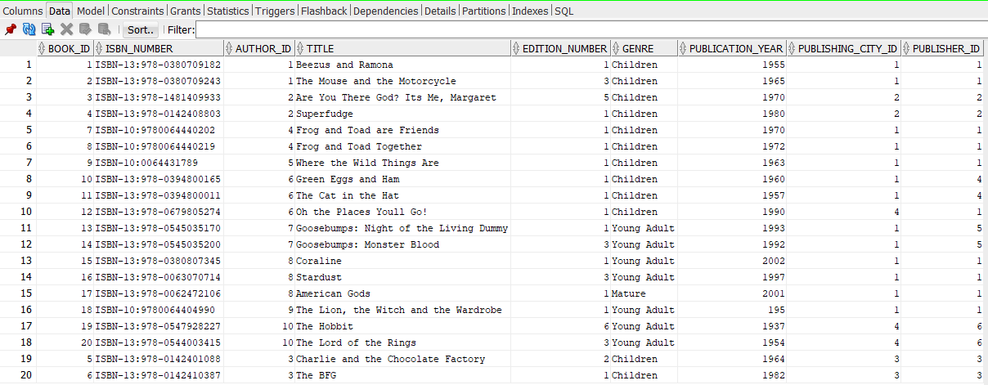
DAtA Entry

Slide 8
Get All Book Data
Select *
FROM Book
LEFT JOIN Author using(Author_Id)
LEFT JOIN Publishers using(Publisher_Id)
LEFT JOIN Publication_Cities using(Publishing_City_Id)

Slide 9
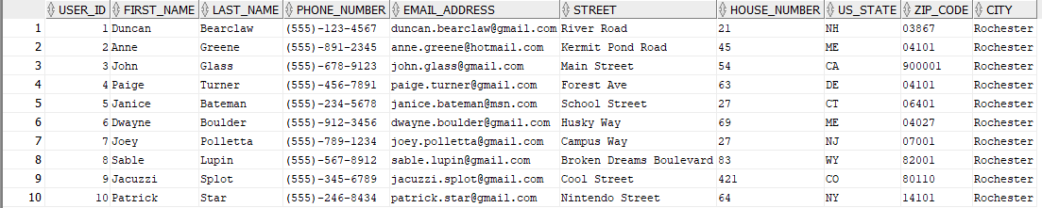
Get All Reader Data
Select *
FROM Reader
LEFT JOIN Reader_Phone_Numbers using(User_ID)
LEFT JOIN Reader_Emails using(User_ID)
LEFT JOIN Reader_Addresses using(User_ID)

Slide 10
Get Book from ISBN
Select Book.*
FROM Book
WHERE ISBN_Number = 'ISBN-13:978-0380709243'

Slide 11
Get all Authors Books
SELECT Book.*
FROM Book
WHERE author_id = (Select Author_ID
FROM Author
WHERE Author_First='Neil' AND Author_Last='Gaiman')

Slide 12
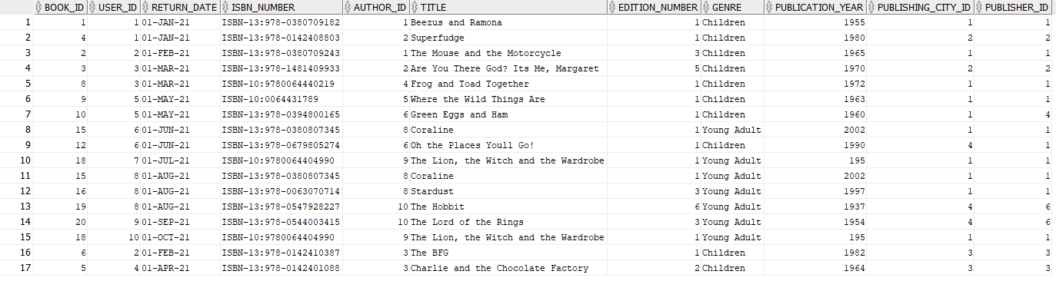
Get all books out on Loan
SELECT *
FROM Books_Out_On_Loan
LEFT JOIN Book using(Book_ID);

Slide 13
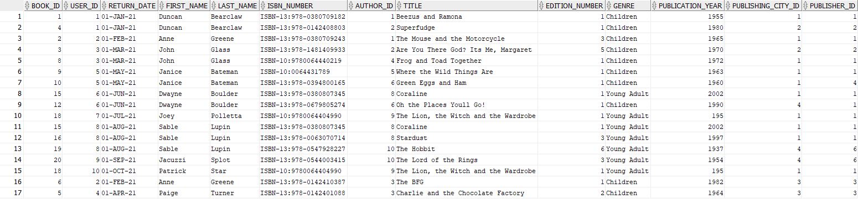
Get all overdue books
SELECT *
FROM(
SELECT *
FROM Books_Out_On_Loan
LEFT JOIN Reader using(User_ID)
LEFT JOIN Book using(Book_ID))
WHERE SYSDATE > Return_Date;

